Slide 1

Council services and funeral costs survey
APPENDIX - INDIGENT FUNERALS
July 2026

Slide 2
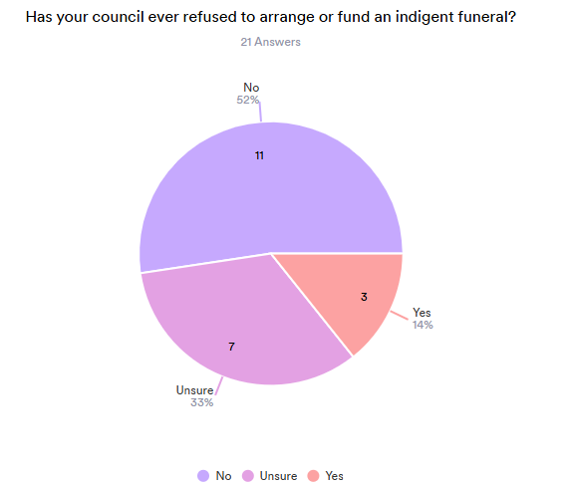
Our core survey shows ‘no money available’ is relatively common, but some funeral directors say council sometimes refused to arrange or fund indigent (pauper) funerals
Why?
“Not their responsibility”
“WINZ grant should cover costs”
“The individual owned property – but it takes 3 years for the funds to come available.”

Slide 3
Why indigent funerals cost more than the WINZ grant
“[Name] died at a local Hostel that is a shelter for homeless and poorer people. [Name] was 75 and had no NOK (next of kin) who would take any responsibility. The Hostel Manager took on the Financial agreement for the funeral.
As there were many fellow members of the hostel who wanted to view [name], we conducted viewings all afternoon in our chapel. [Name] was dressed and feature set for viewing.
We applied to the [Name] Council for an indigent persons cremation. We were refused on the basis that the WINZ grant should cover our costs. We appealed this ruling only to have the Cemetery and Crematorium manager refuse us again.
As we had applied to the [Name] Council Crematorium for the cremation our legal authority to cremate [name] was approved for that crematorium. As a result the cremation cost much more than a cremation costs us at our normal provider. Example our cremator charges us $850.00. The Council charged us $1058.53. So not only did we get refused to have an indigent cremation (No charge) but it actually cost $208.53 more than it would of if we had used our crematorium.
The Hostel Manager who took on the funeral account (Debt) paid out of his own pocket the costs that were left after the WINZ payment. Total account was $3513.60
Bearing in mind that I had agreed to keep the costs down as the Manager was acting as the Executor.
Because we used the [Name] Council crematorium the travel kilometres were more and staff time. 45 mins more driving time.”

Slide 4
Other problems with indigent funerals
“The lack of funding from WINZ - Funeral Directors do not always have access to a deceased person financial situation so we are flying blind when it comes to organising a destitute burial. Often there are situations where they have been at hospital for many weeks unclaimed and they may have had money in their account but their expenses have run it dry and then we apply for WINZ and its declined due to the fact they had money at their time of death but its gone now and we are out of pocket.”

Slide 5
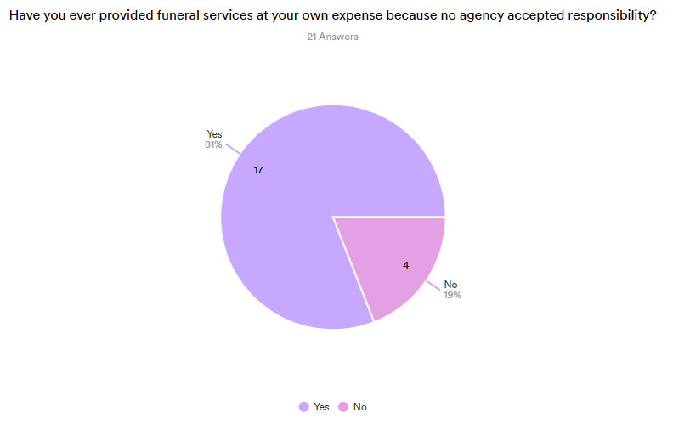
Funeral homes end up paying
How much?
“$1,500 one funeral”
“$2,000 ish”
“$3K”, “$3,000”
“Approx $3,000 - $4,000 per funeral”
“Easily in the thousands over the years. I can see why some funeral homes request deposits.”
$7,500”

